Slide 1
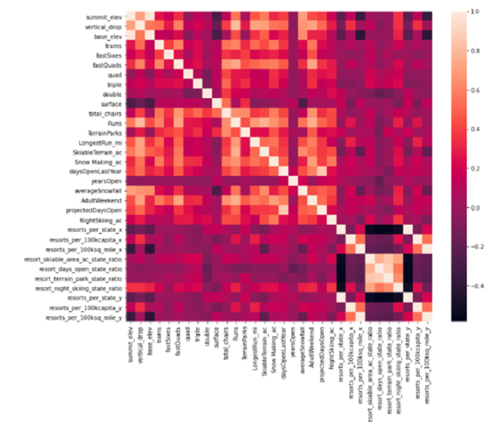
What can drive ticket price higher?
Four things:
Vertical drop
fastQuads
Runs
Snow making
It would be best to review only these
Features.

Slide 2
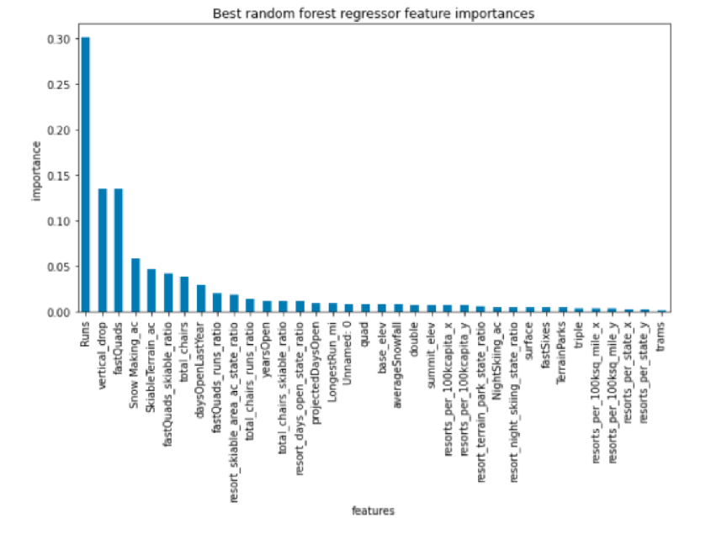
Using the random forest model, I would
recommend adding 2 acres of snow making,
increasing the vertical drop by 150 feet,
and installing an additional chair lift. This
increases support for ticket price by $15.42

Slide 3
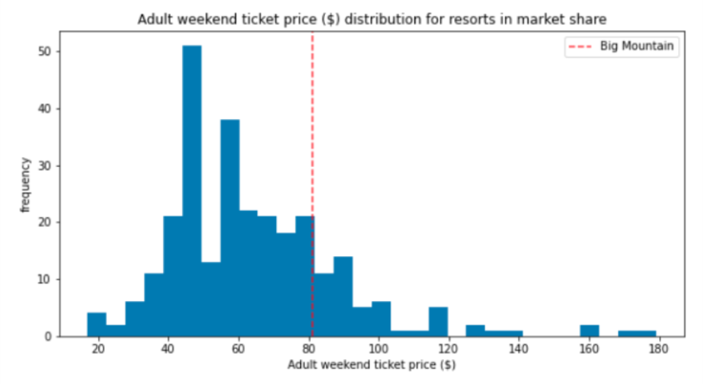
Results show that the Big Mountain Resort ticket price is towards the higher end of the distribution, but not the highest.

Slide 4
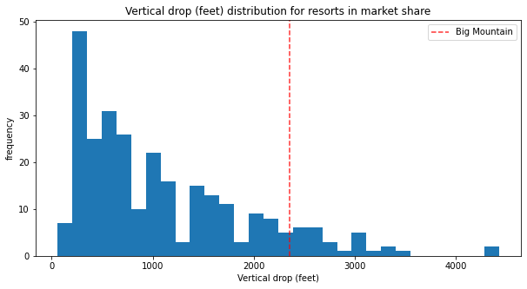
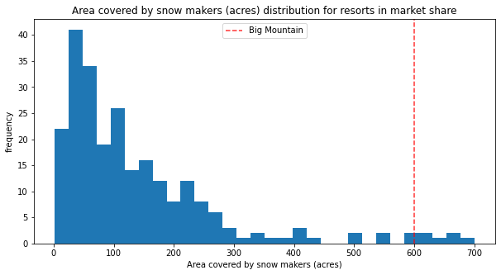
Vertical drop and acres of snow could increase
and it would not be considered abnormal because
other resorts are higher in comparison

Slide 5
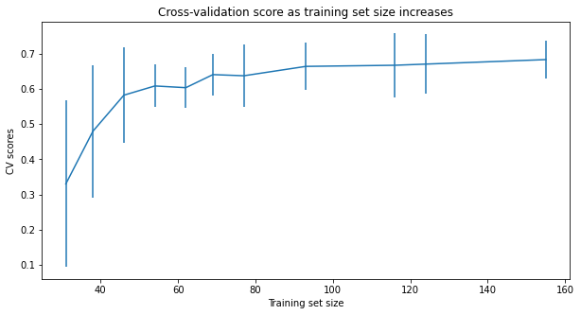
One concern was that there was about 16% that had to be removed for the model, but this learning curve shows that there was enough data, levelling off by around a sample size of 40-50.

Slide 6
Conclusion:
Be wary of adding too much. Data also shows that on average, the larger the resort, the cheaper the ticket price. The same could be said for the number of chairs.
This information should be reviewed by data analysts to decide which options seem the most plausible.

